Slide 1

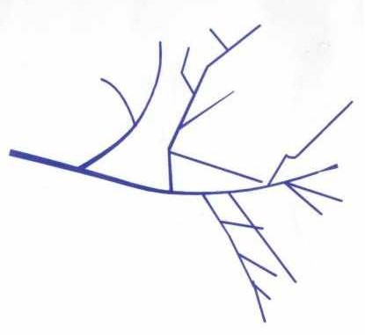
Nocardia
The members of Nocardia are prominent causes of disease in human & animals. Nocardia are strickly aerobic, non-motile, pleomorphic G+ organisms. They do not form spores, & may take the form of rods, cocci, or diphtheroids, although sometimes produce branching filaments & aerial hyphae. Nitrate reduction and catalase production are characteristic. Some are partially acid fast.
Like other aerobic actinomycetes, Nocardia are found commonly in soil, decaying vegetation, fresh & salt water & in animal faeces.
Approximately 12 species included in the genus of Nocardia. N. asteroids together with N. farcinica & N.nova constitute the N. asteroides complex. N.asteroides is found frequently in temperate regions, whereas, N. brasiliensis is more common in tropical & subtropical areas.

Slide 2

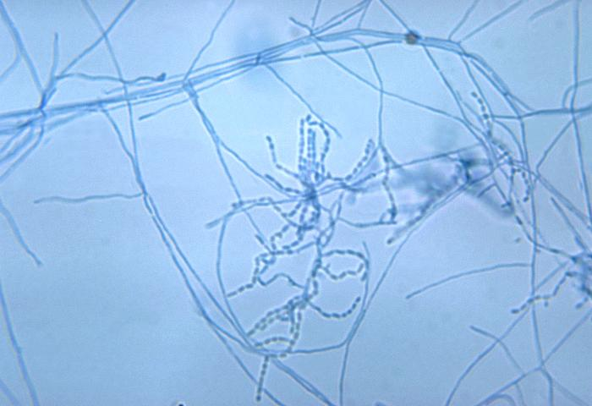
Disease, Epidemiology, & pathogenesis
N.asteroides is the most frequently reported pathogen of human & other animals, followed by N.brasiliensis.
N. bresiliensis has been isolated from horses with pneumonia & pleuritis.
Clinical signs of N.asteroides infection begin with the appearance of an indurated nodule or pastule, which ruptures & suppurate. Discrete lesions are often joined by sinuses & chronic progressive disease follows in untreated cases. The organism isolated from acute or chronic mastitis in cows with granulomatous lesions. & draining fistula. In horses skin infection & lymph node abscessation are common presentations which occasional respiratory or disseminated disease in immunosuppressed animal. Nocardial abortion occurs in horses & pigs.

Slide 3

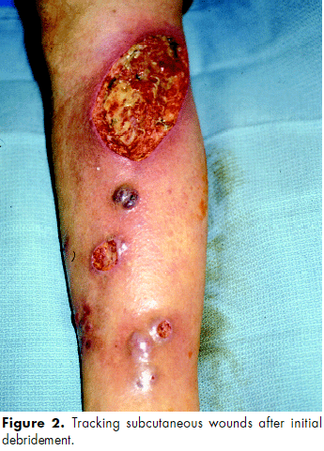
Disease, Epidemiology, & pathogenesis
In humans, Nocardiosis takes subcutaneous & pulmonary forms; Some human strains are neurotropic & systemic disease often involve the CNS. The incidence of pulmonary nocardiosis may be increasing because of decreased average immunocompetence in the population in general. & to a higher degree of clinical recognition. Nocardiosis is often associated with chronic obstructive pulmonary disease and acquired immunodefficiency syndrome (AIDS). Corneal infection sometimes follow trauma & may be associated with contact lens wear & laser assisted in situ keratomileusis. Nocardiosis is not communicable.
Cell wall mycolic acid, including trehalose-dimycolate, contribute to virulence, perhaps by inhibition of phagosome-lysosome fusion in macrophages. Filamentous forms are more viluent than coccoid forms, perhaps relating to invasiveness. Membrane bound catalase & superoxide dimutase are probably involved in resistance of nocradia to killing by neutrophils.

Slide 4
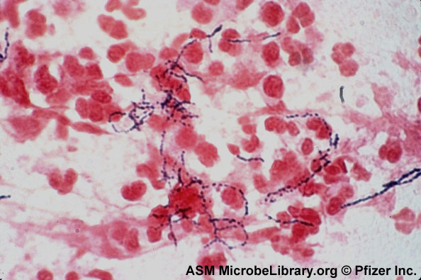
Diagnosis
Members of the genus Nocardia were originally classified as fungi, based on presence of cell wall muramic acid, lack of membrane bound nucleus & mitochondria, & sensitivity to antibacterials.
The presence of G+ acid-fast, branching filaments in smear suggestive of nocardial infection. Specimens should be cultivated on blood or Sabouraud’ agar & incubated at 25C & 37 C for 4-5 days. Culture have wet dirt odor.
Surface hyphae are fine filaments branched at right angle. The presence of aerial hyphae differentiate the genus nocardia from related genera. Colonies of Nocardia on blood or chocolate agar are small after 48 hrs incubation. Isolates may be hemolytic on sheep or bovine blood agar, but most strains of nocardia are non-hemolytic. Colonies of N.asteroides may be orange tan with white to pinkish aerial mycelium.
Detection of Abs in patients with systemic disease can be done by IF microscope Or ELISA.

Slide 5
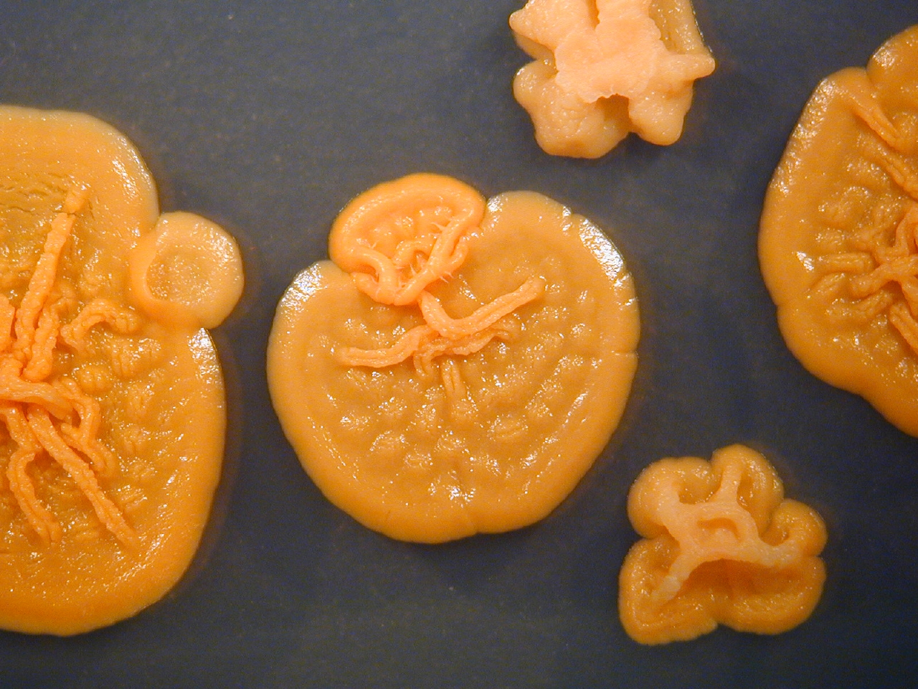
N.asteroides colonies on blood agar

